Slide 1
NERVE SEGMENTATION IN ULTRASOUND IMAGES
Presented by
P. Sai Charan 17N31A12C4
Samreen Sultana 17N31A12D7
Shail Faisal Malik 17N31A12E4
Project Guide
Asst. Prof A. Yogananda

Slide 2
Project overview
The ultrasound scans are very important to detect any kind of injury or disease in human body because it used to scan the internal tissues of the body.
One major disadvantage of these images is that they include huge amount of noise so doctors face difficulty in finding the exact location of the nerve where they have to inject the medicine to operate.
These pictures are not clear enough to find the nerve at once so they have to inject needle very times.
So in our project we can find the nerve very easily because it includes the segmentation of these nerves in ultrasound images.

Slide 3
OBJECTIVE
This project aims at identifying the nerves, using canny edge detection.
We take the patient details generate the medical report based on symptoms and we show nerve detection in ultrasound images.
Canny edge detection is a technique to extract useful structural information from different vision objects and dramatically reduce the amount of data to be processed.
It has been widely applied in various computer vision systems.

Slide 4
implementation
First we apply some preprocessing techniques to the ultrasound images to reduce noise from images.
Then these images are used for nerve segmentation.
For nerve segmentation we use canny edge detection algorithm.
Using this algorithm the nerve area is predicted in the set of ultrasonic images.

Slide 5
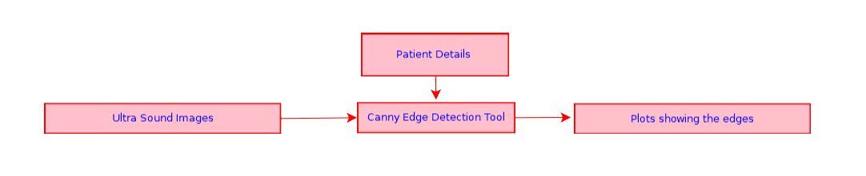
Flow diagram

Slide 6
Programming language and tools
This tool is developed by using Python language along with its layout toolkit PyQt, PyUIC and OpenCV.

Slide 7
outcome
Ultra Sound Images are to be provided as Input to the system, using the corresponding user interfaces. The system generates the plots showing canny edges by which the nerves can be identified.

Slide 8
Flow of execution
First open the main GUI Screen.
Then enter patient details.
Enter symptoms
Give input Ultrasound image .
Generate medical report.
Nerve detection.

Slide 9
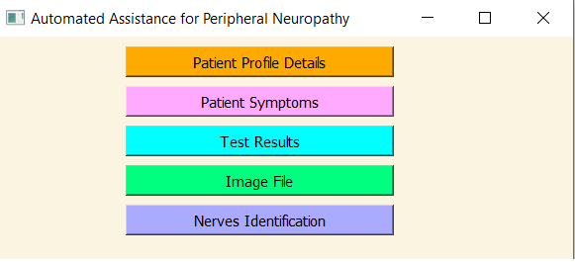
Main Output screen

Slide 10
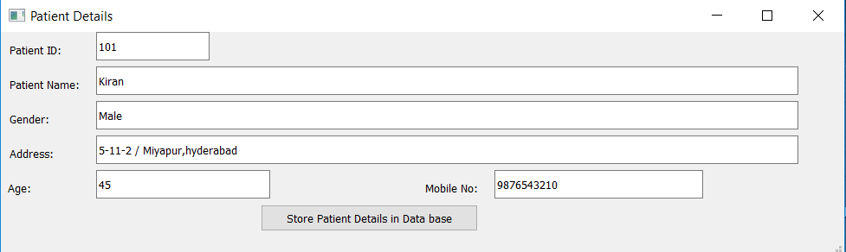
Patient details screen

Slide 11
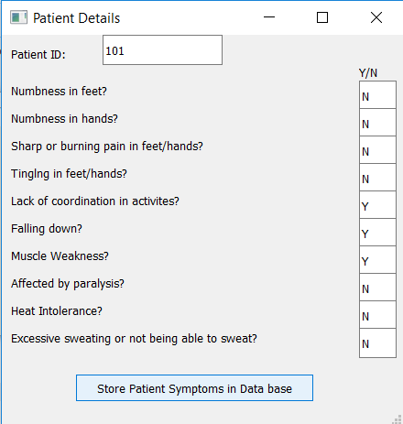
Patient symptoms screen

Slide 12
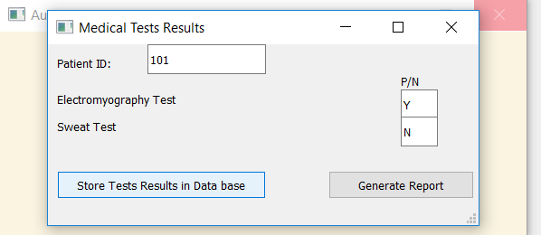
MEDICAL RESULTS SCREEN

Slide 13
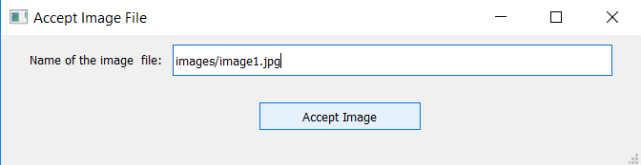
Accepting image

Slide 14
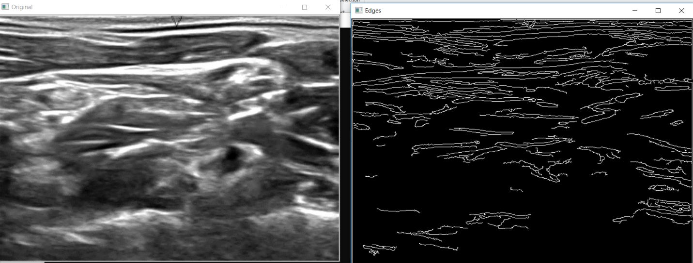
Nerves detectiion

Slide 15
ADVANTAGES
The project is useful for doctors in identifying the nerves.
The project is also useful in analyzing the Ultra Sound images, which are difficult to analyze, because of low quality/noise in the image
This project finally leads to the improvement of quality of the patients life.

Slide 16
CONCLUSION
This project is useful for doctors in identifying the correct location of the nerves. The project is also useful in analyzing the Ultra Sound images, which are difficult to analyze, because of low quality/noise in the image. This project finally leads to the improvement of quality of the patients life.

Slide 17
THANK YOU

